Slide 1
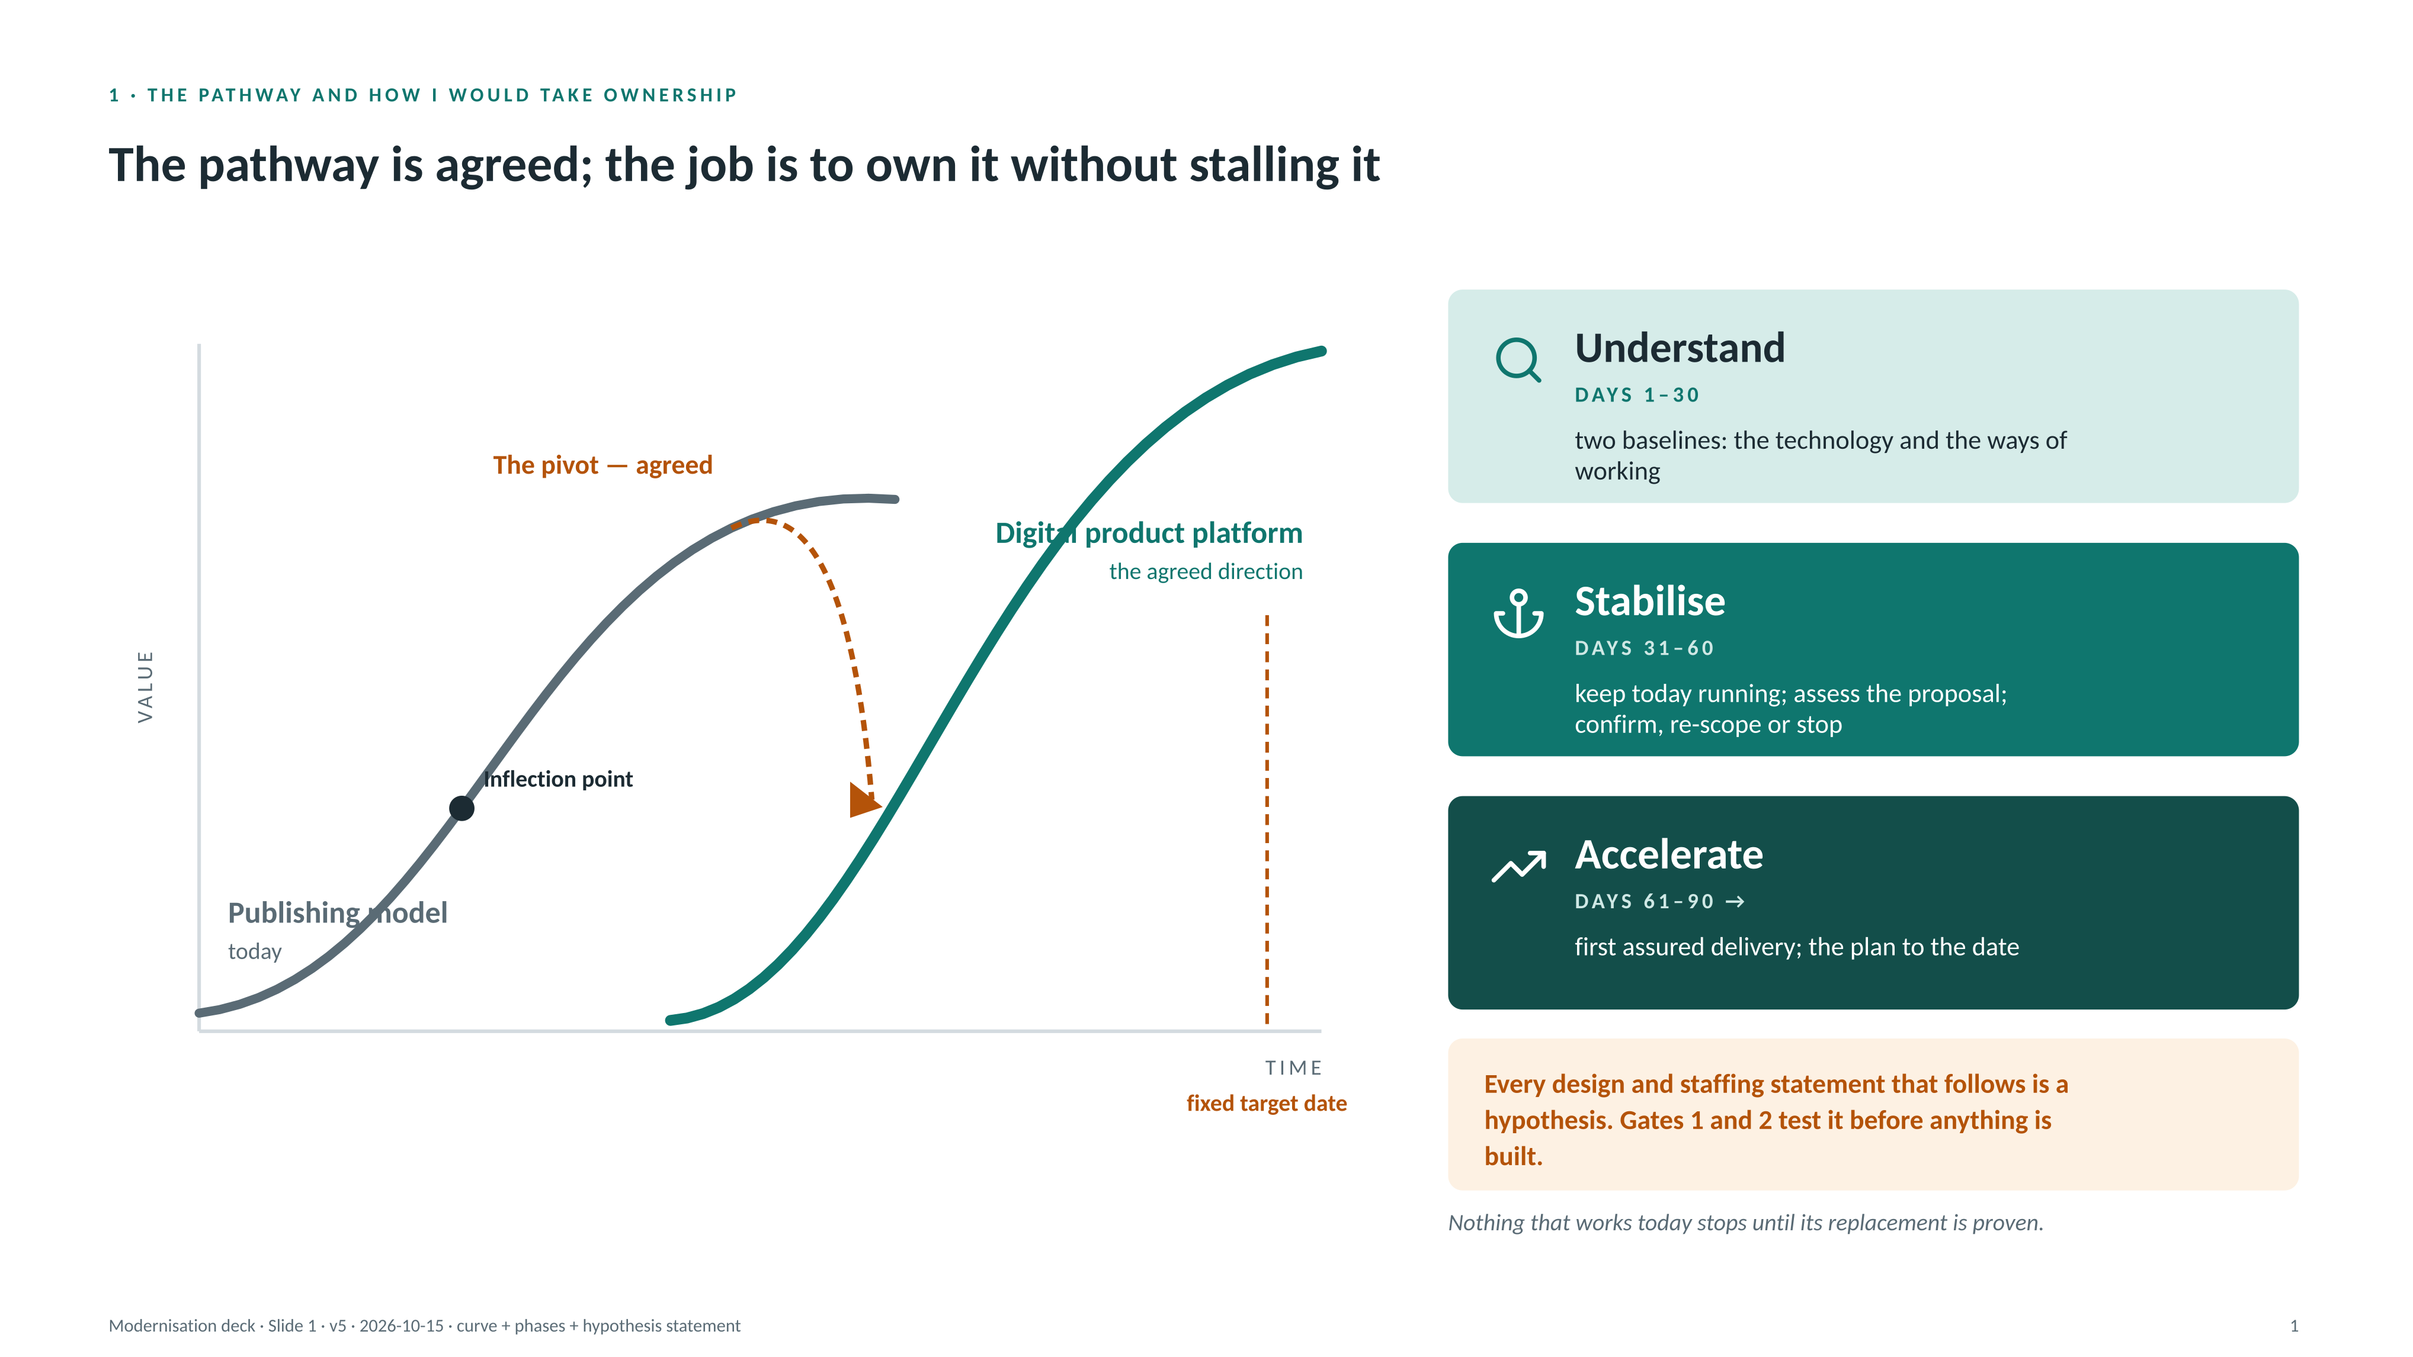
Notes:
FACTS (from the source material)
- Direction: from a publishing model to a digital product platform. The strategy material frames this as an inflection point, visible only in hindsight.
- The target architecture is a vendor proposal, not yet owner-assessed. The target date is fixed. The proposed team is a CTO plus roughly 4.6 FTE.
- Current estate: a public website, a content/SaaS authoring product, a CRM behind them. An MSP is in place; some things are SaaS, some in-house.
HOW TO TALK TO THE CURVE
- The decision to move curves is made; the work is execution without losing today's revenue, customers or content integrity. The pivot is agreed; what is not yet settled is the shape of what we build and how we work.
HYPOTHESIS STATEMENT (new on this slide)
- Say it out loud before moving on: every design and staffing statement that follows is a hypothesis; Gates 1 and 2 test it before anything is built. This is what reconciles the solution slides with the delivery argument.
THE THREE PHASES (and what each means for this programme)
- Understand (days 1–30): two baselines — the technology and product baseline, and the ways-of-working baseline (processes, SOPs, SLAs, mandated requirements). Inventory what is live, in flight and contracted; read the proposal with its author.
- Stabilise (days 31–60): keep today running — no big bang. Tier the architecture (slide 2). Confirm, re-scope or stop in-flight work, each with a reason. Put the operating rhythm in place in week two, not week twelve.
- Accelerate (days 61–90 →): first assured delivery on the bullet-proof core; the backward plan to the date agreed with partners.
- Momentum rule: nothing that works today stops until its replacement is proven; nothing new starts without an owner and a gate.
ASSUMPTIONS (mine, to be challenged)
- Authoritative content is the core asset; commerce, identity and CRM are plumbing.
- Most build and all commodity operations will come from partners; the in-house team owns judgement, design and assurance.
- A board and a risk committee exist and the programme reports into them.
- Editorial and content operations sit outside this role; the content platform (as technology) is in scope.
- Some in-flight work will be confirmed, some re-scoped, some stopped.
TO CONFIRM IN THE FIRST 30 DAYS
- Which partners beyond the MSP are contracted, and for what. Which third-party integrations are live and must be preserved. What is in flight, its state and owner. The split of individual, institutional and embedded customers and revenue. Run cost and end-of-life dates for current systems.
[PROMPT] Opening example: a time you inherited an agreed direction mid-flight and kept momentum while reshaping it. One sentence here, detail on slide 3.

Slide 2
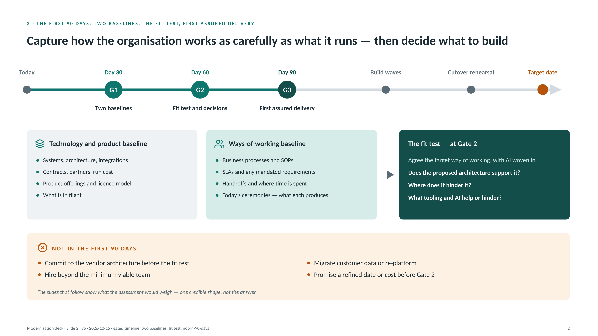
Notes:
THE GATES
- Gate 1 (day 30) — two baselines. Technology and product: systems, architecture, integrations, contracts, partners, run cost, product offerings and licence model, what is in flight. Ways of working: business processes and SOPs, SLAs and any mandated requirements, hand-offs and where time is actually spent, today's ceremonies and what each produces. Output: a one-page baseline and a confirmed list of what is in flight.
- Gate 2 (day 60) — the fit test and decisions. Agree a preferred target way of working with AI woven in. Then ask of the proposed architecture: does it support that way of working; where does it hinder it; what tooling and AI would help or hinder. Tiering confirmed; Tier A design confirmed; in-flight work confirmed, re-scoped or stopped; partner scope and commercials agreed; the backward plan to the date drafted with partners. Output: the plan the organisation will be held to, with its risks.
- Gate 3 (day 90) — first assured delivery. Candidate: the identity and entitlement foundation, or the content pipeline — whichever the baseline shows is the constraint. Output: proof the path works end to end on something real.
WHY TWO BASELINES
- The vendor proposal captures technologies and products. It does not capture how the organisation works, and that is where the AI and commodity-tool savings live. Systems thinking applies to both: you cannot judge whether a target architecture is right without knowing what it has to support.
- The ways-of-working baseline is the ceremony audit applied to the organisation: for each process, what does it produce that could not come from the data or the tooling?
NOT IN THE FIRST 90 DAYS
- Commit to the vendor architecture before the fit test; migrate customer data or re-platform; hire beyond the minimum viable team; promise a refined date or cost before Gate 2; start any AI platform before its governance exists.
WHAT IS AT RISK IF A GATE SLIPS
- Gate 1: we plan on assumptions and in-flight spend continues unexamined. Gate 2: partners build to an unassessed design and the date becomes a hope. Gate 3: no proof the path works; cutover rehearsal arrives without rehearsal.
ASSUMPTIONS
- The fixed date allows at least two build waves and a cutover rehearsal after day 90. If it does not, Gate 2 brings a scope decision to the board.
[PROMPT] Fixed-date example: delivering to an external date by flexing scope through gates rather than flexing the date.
BRIDGE OUT
- 'The next three slides show what the assessment would weigh — one credible shape, not the answer.'

Slide 3
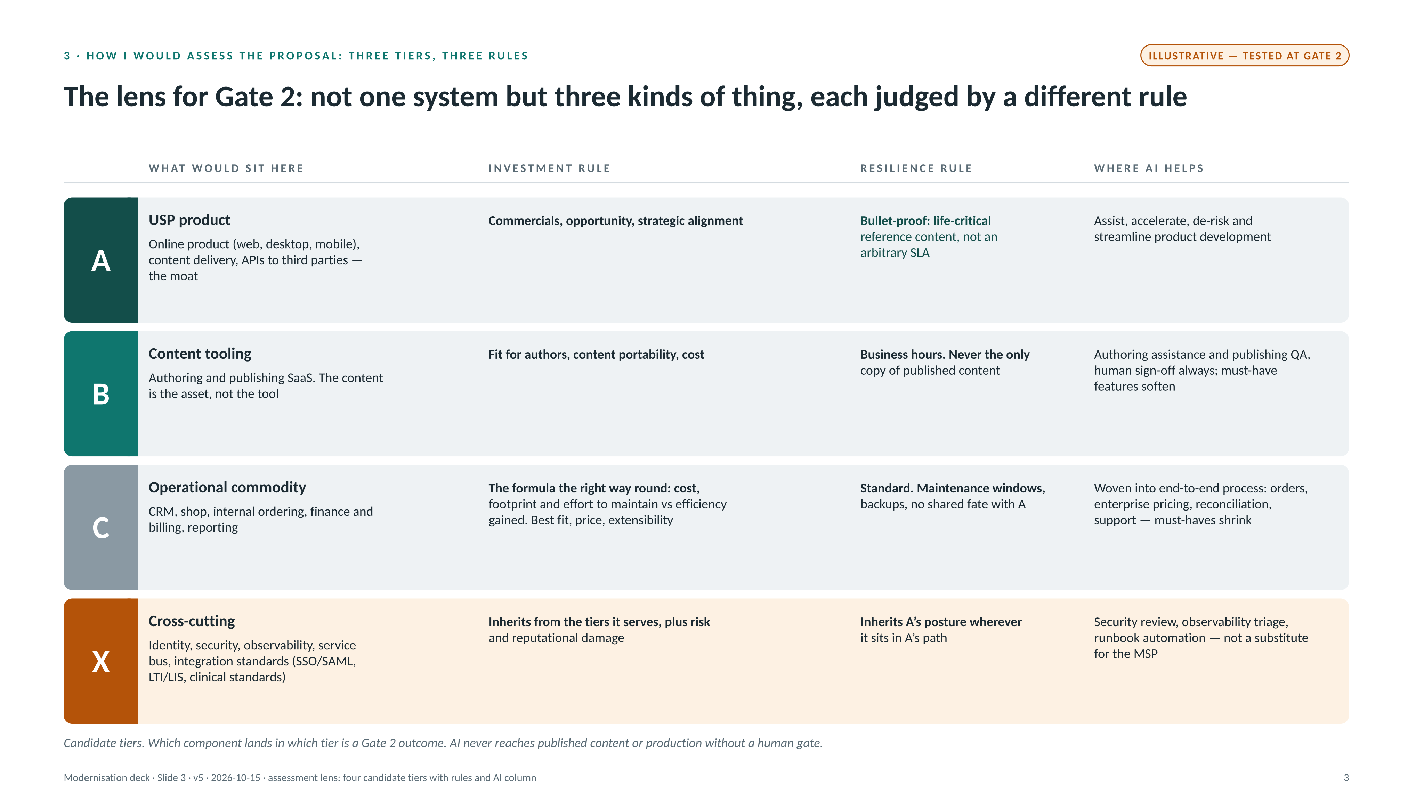
Notes:
FRAMING FOR THIS SLIDE
- Everything here is illustrative and is tested at Gate 2. Present it as 'one credible shape the assessment would weigh', never as the design. The amber tag on the slide says so.
THE LENS (applied at Gate 2)
- The proposal draws one system. We should treat it as four kinds of thing, judged differently:
A — USP product: the online product (web, desktop, mobile), content delivery and APIs into third-party systems. The moat. Investment is judged on commercials, opportunity and strategic alignment. Resilience: bullet-proof — this is life-critical reference content, not an arbitrary SLA.
B — Content tooling: authoring and publishing SaaS. Integral and niche, but the content is the asset, not the tool. Judged on fit for authors, content portability and cost. Resilience: business hours; never the only copy of published content. No advantage is gained by building this better.
C — Operational commodity: CRM, shop, internal ordering, finance and billing, reporting. Many products would do; building our own would be possible but senseless. The formula the right way round: cost, footprint and effort to maintain are judged against the operational efficiency gained. Select on best fit, price and extensibility. Resilience: standard, with no shared fate with A.
X — Cross-cutting: identity, security, observability, service bus, integration standards (SSO/SAML or Shibboleth, LTI/LIS for universities, clinical standards where relevant). Investment inherits from the tiers it serves and is additionally judged on risk and reputational damage. Inherits A's posture wherever it sits in A's path.
THE AI LINE
- A: AI assists, accelerates, de-risks and streamlines product development — specification, code, test generation, review, release evidence. More capability from the same people.
- B: authoring assistance, consistency checks, publishing QA — always with human sign-off on authoritative content. Previously must-have tool features soften: choose the tool for content portability and let AI fill workflow gaps.
- C: AI woven into end-to-end operational practice — order handling, the enterprise-deal pricing step the proposal describes as "calculated via Excel and manually entered", reconciliation, reporting, support. Must-have feature lists shrink; the formula tilts further toward the cheapest fit.
- X: security review, observability triage, runbook automation. Reduces the 24×7 burden a team of six cannot carry alone, but is not a substitute for the MSP.
- Guardrail: AI output never reaches published content or production without a human gate. Adoption is measured on cycle time and quality, not on usage.
ASSUMPTIONS
- Which component lands in which tier is a Gate 2 outcome. The tiering and the availability stance are our assessment, not the vendor's framing. The source states no SLA.
[PROMPT] Commodity-over-build example: a CRM, billing or shop decision you made on price plus extensibility, and what it freed the team to do.

Slide 4
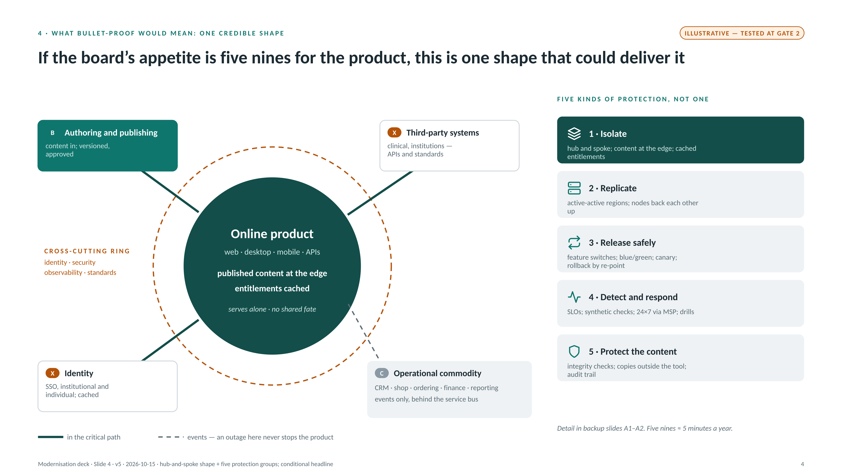
Notes:
FRAMING FOR THIS SLIDE
- Everything here is illustrative and is tested at Gate 2. Present it as 'one credible shape the assessment would weigh', never as the design. The amber tag on the slide says so.
HOW TO TALK TO THE HUB AND SPOKE
- The hub is Tier A: the online product with published content held at the edge and entitlements cached. Everything else is a spoke.
- Solid edges are synchronous and in the product's critical path: authoring publishes content in; identity answers "who is this"; third-party systems read through APIs and standards. Each of these is built to the product's standard (cross-cutting inherits A's posture).
- Dashed edges are asynchronous events through the service bus: orders, licence changes, usage, invoices. An outage in CRM, shop, finance or reporting never stops the product; events are replayed when they recover.
- The outer ring is cross-cutting: identity, security, observability, standards. Judged on risk and reputational damage as well as the tiers they serve.
- The "AI-assisted process" marker on the commodity cluster is where human steps soften: order handling, enterprise pricing, reconciliation, support.
WHAT THIS CHANGES FROM THE PROPOSAL
- The proposal shows three order-capture paths (web shop, internal shop with manual pricing, finance for non-e-commerce subscriptions). Here they are one commodity cluster behind the bus; whether they become one order flow is a Gate 2 question, not a decision today.
- The proposal places the service bus in the API layer. Here it is on the spoke side only; it must never be in the hub's read path.
ASSUMPTIONS
- Third-party embedded delivery (APIs into clinical and institutional systems) sits in Tier A with the same posture.
- Entitlement grace behaviour — serve content when identity or CRM are unavailable, reconcile later — is the ethical default to agree.
THE FIVE KINDS OF PROTECTION (names only on the slide; backup slides A1 and A2 carry the detail)
1 Isolate — no shared fate: hub and spoke with commodity behind the bus; published content at the edge; entitlements cached with grace; a read-only degraded mode; bulkheads, circuit breakers and back-pressure so one slow dependency cannot take the product down.
2 Replicate — no single point: active-active across regions; stateless services with replicated data; an identity-provider outage plan; SaaS and vendor failover plans; capacity headroom proven by load testing.
3 Release safely — no big-bang change: feature switches (ship dark, release deliberately); blue/green deployment; canary by cohort with automated rollback; expand/contract schema changes; immutable, versioned content releases.
4 Detect and respond — minutes, not hours: SLOs and error budgets; synthetic checks from customer locations; runbooks with 24×7 on-call via the MSP; a status page and incident communications; game days and DR drills with stated RTO/RPO.
5 Protect the content — integrity above all: checksums and integrity checks on published content; copies held outside the authoring tool; replay from the bus after outages; an audit trail of what changed, when and by whom; AI-generated test evidence behind a human gate.
POSTURE BY TIER
- A: all five groups. B: groups 5 and 3 — business hours, vendor SLA, published copy held outside the tool. C: standard — maintenance windows, events replayed from the bus. X: inherits A wherever it sits in A's path — groups 1, 2 and 4.
- Cost sits where the risk is: this is also the argument for not over-engineering Tier C.
FIVE NINES
- 99.999% is roughly five minutes of unavailability a year. It is our position argued from the nature of the content; the source states no SLA. The slide frames it as the board's risk-appetite decision, which the Gate 2 assessment would size.
[PROMPT] Life-critical availability example (clinical or health-information system you ran). [PROMPT] Vendor-proposal example (a design you inherited, kept the direction, changed the shape).

Slide 5
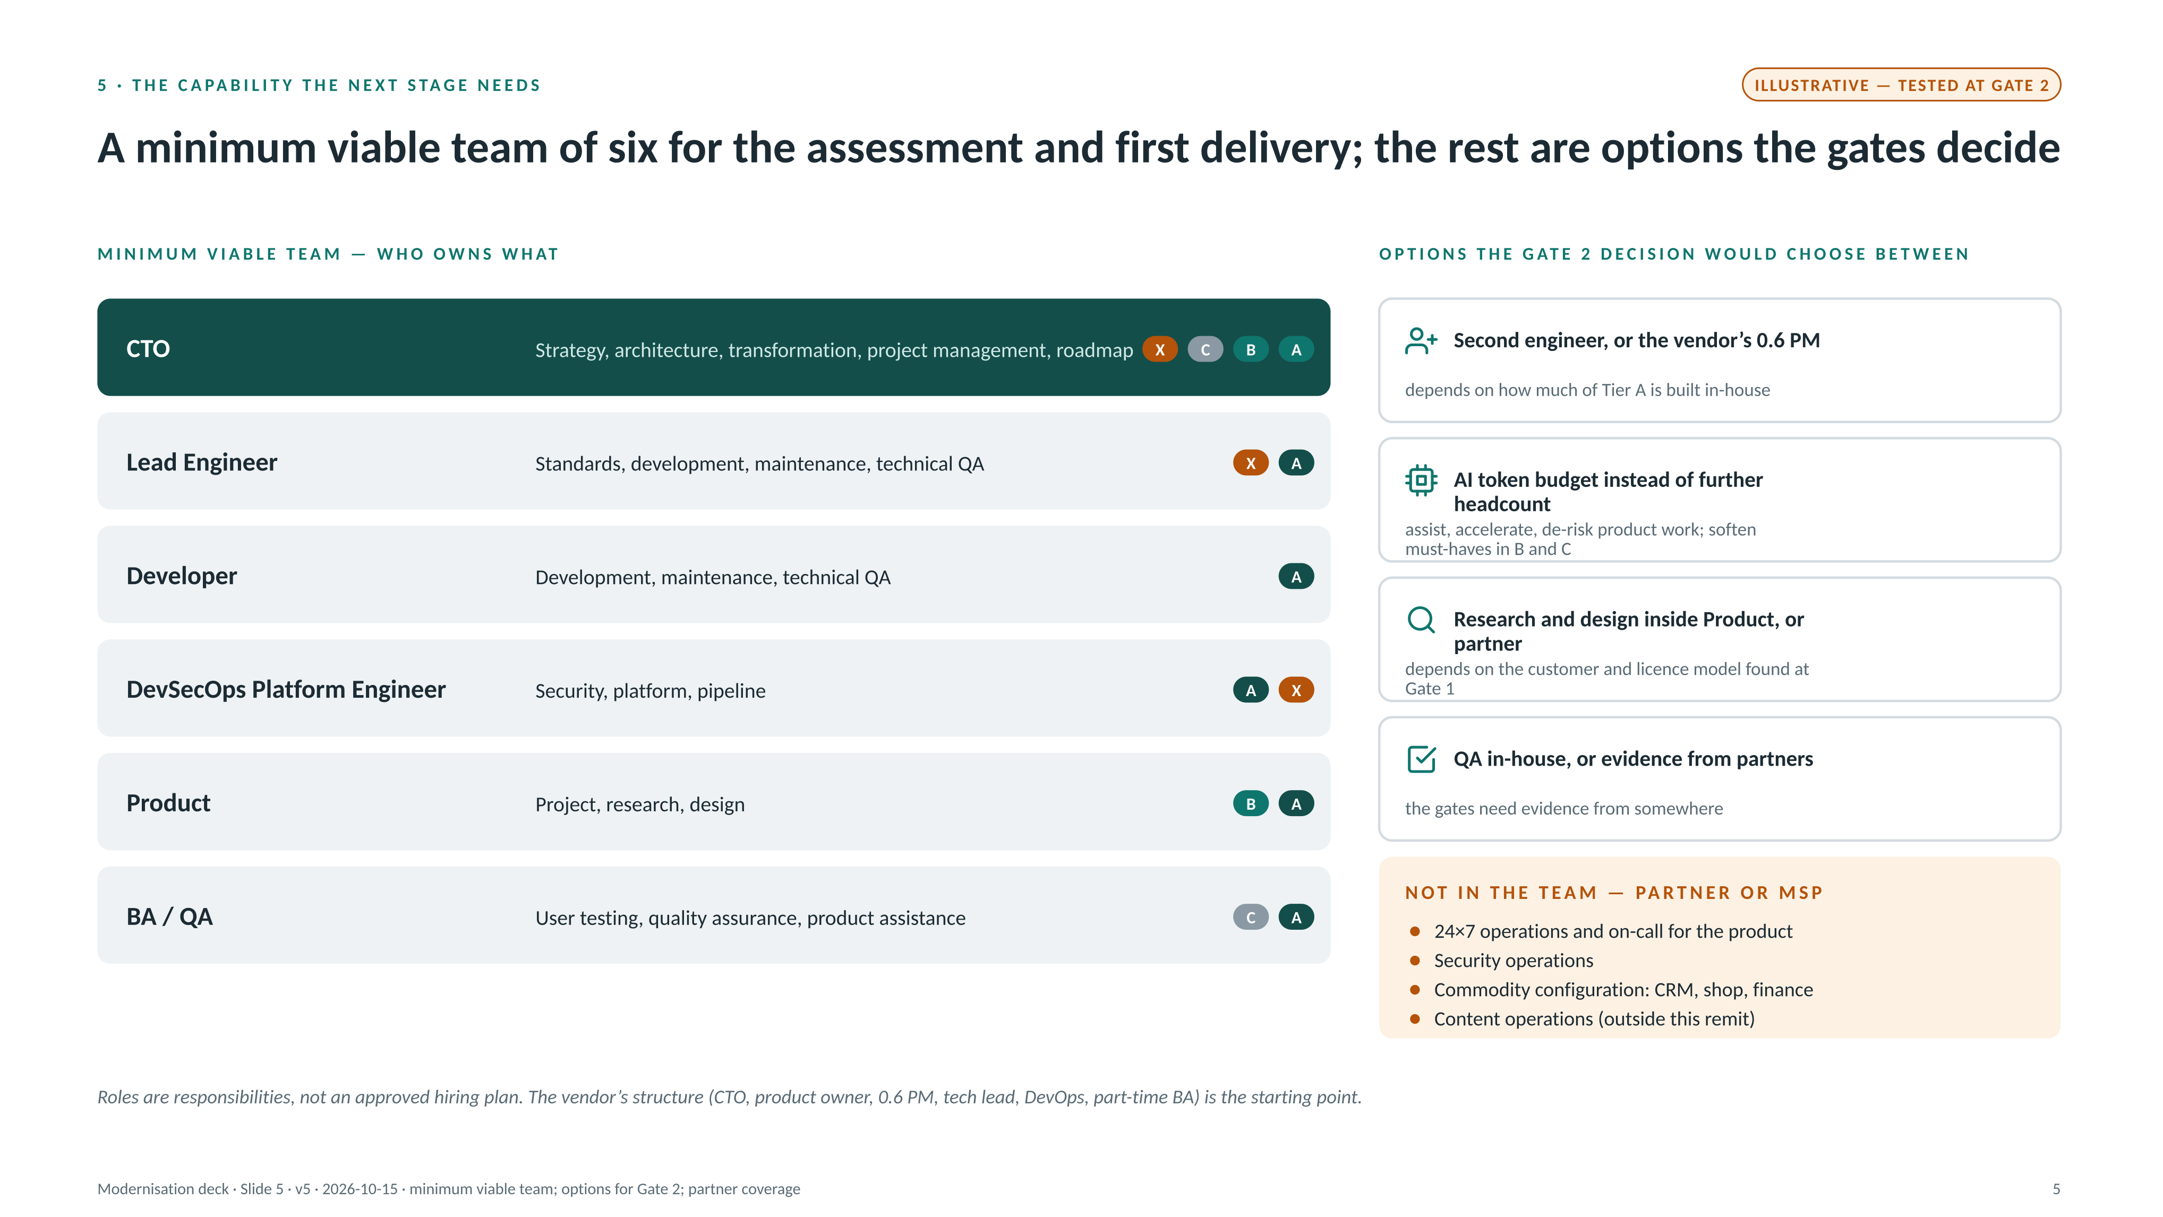
Notes:
FRAMING FOR THIS SLIDE
- Everything here is illustrative and is tested at Gate 2. Present it as 'one credible shape the assessment would weigh', never as the design. The amber tag on the slide says so.
WORKED BACKWARDS FROM TWO POINTS
- From the tiers: A needs engineering depth and platform resilience in-house; B needs a product owner for content tooling and a partner relationship; C needs configuration, integration and partner management, not builders; X needs DevSecOps and standards knowledge.
- From the CTO's responsibilities — strategy, architecture, digital transformation, project management, roadmap — everything else must sit with another role or a partner.
THE MINIMUM VIABLE TEAM
- CTO: strategy, architecture, transformation, project management, roadmap (all tiers).
- Lead Engineer: standards, development, maintenance, technical QA (A, X).
- Developer: development, maintenance, technical QA (A).
- DevSecOps Platform Engineer: security, platform, pipeline (X, A's resilience).
- Product: project, research, design (A, B).
- BA/QA: user testing, quality assurance, product assistance (A, C).
OPTIONS THE GATE 2 DECISION WOULD CHOOSE BETWEEN (previously framed as differences; now options) (CEO → CTO → Digital Product Owner + part-time BA, 0.6 PM, Technical Lead + DevOps Engineer)
- A second engineer instead of a 0.6 PM: Tier A needs two pairs of hands for five nines, and it removes the single-engineer key-person risk; project management sits with the CTO.
- AI token budget and adoption: any headcount beyond the six is converted into an AI budget aimed at assisting, accelerating and de-risking Tier A work, and at softening must-haves in B and C. Amount to be set against the headcount it replaces — not invented here.
- Product gains research and design; BA gains QA and user testing — the evidence at the gates has to come from somewhere.
NOT IN THE TEAM — PARTNER OR MSP
- 24×7 operations and on-call for the product; security operations; commodity configuration (CRM, shop, finance); content operations (outside this remit).
THINK DIFFERENTLY (if asked)
- Own judgement, not headcount: the in-house team decides what, why and whether; partners decide how.
- Key-person risk is the real risk: decisions written down, runbooks current, pairing with partners so nothing lives in one head.
- Operations is a product, not a project: platform operations and product ownership are standing capabilities; the PM role is temporary by design.
- Grow the differentiating layer: identity, entitlement and content APIs are what competitors cannot buy; buy everything else.
ASSUMPTIONS
- Both structures are proposals; roles are responsibilities, not an approved hiring plan.
[PROMPT] Partner/MSP example: running 24×7 through a partner while keeping design authority in-house — what the contract and the weekly review looked like. Also: building capability from a small start (EMIS, CallCredit) if the audience asks what "thin team" means in practice.

Slide 6
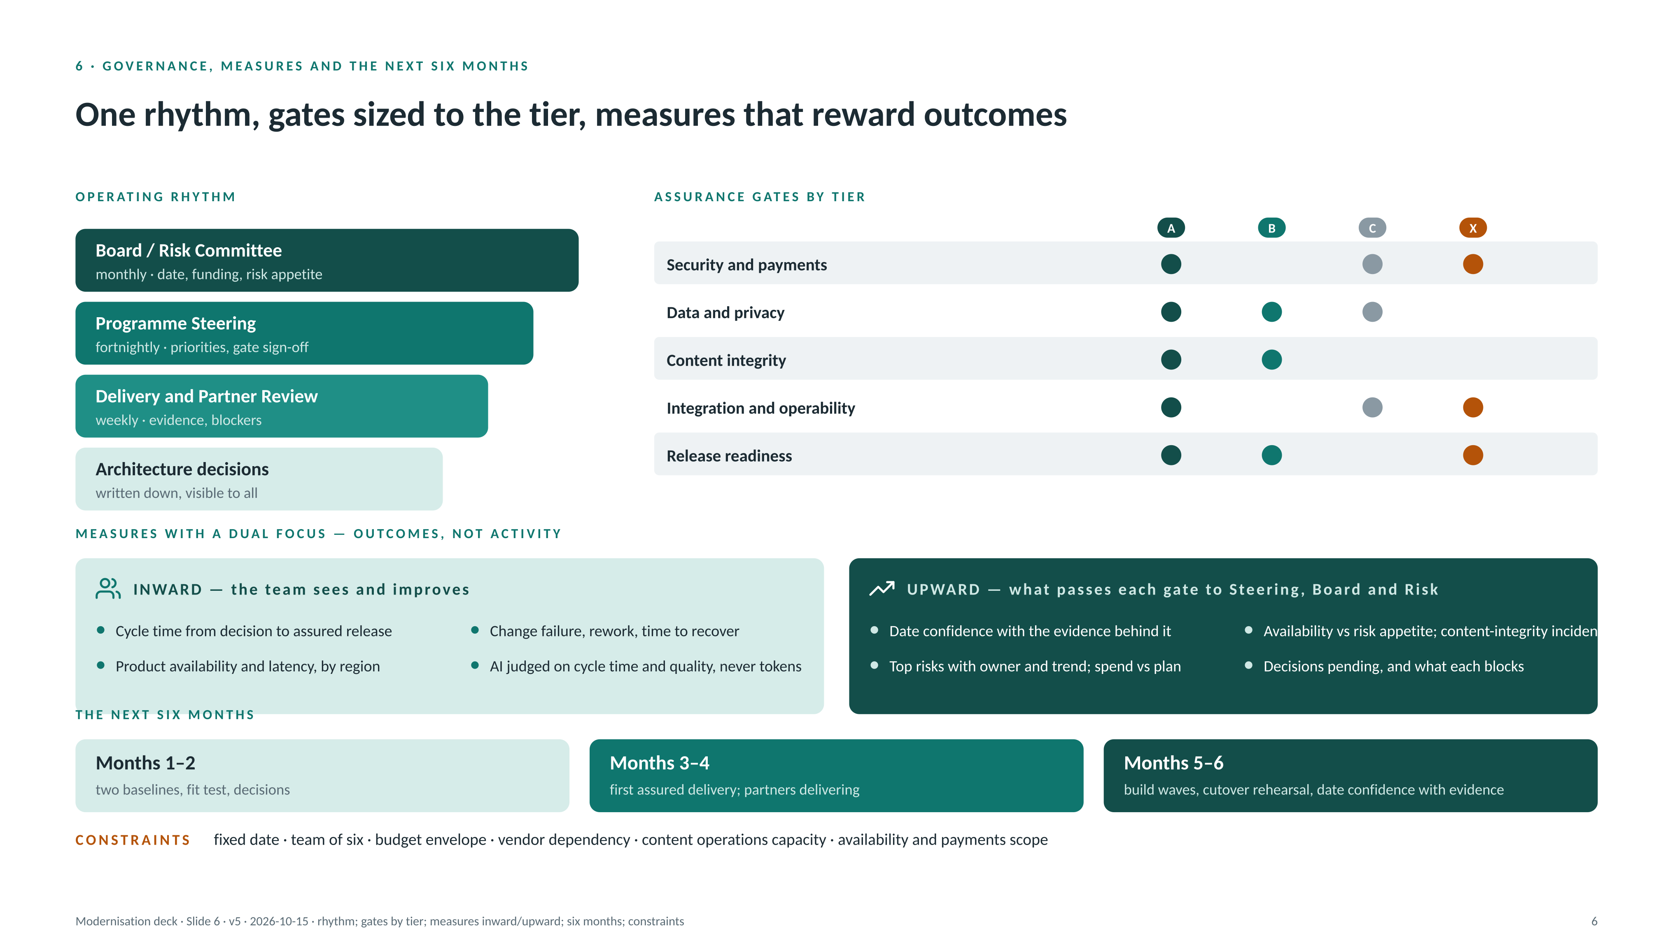
Notes:
OPERATING RHYTHM (assumes a board and risk committee exist; the programme reports into them)
- Board / Risk Committee — monthly or by exception: target date, funding envelope, risk appetite (including the availability stance), policy exceptions.
- Programme Steering — fortnightly: CEO, CTO, product owner, partner leads: priorities, trade-offs, partner performance, gate sign-off.
- Delivery and Partner Review — weekly: CTO, lead engineer, product, partner delivery leads: plan vs actual, blockers, assurance evidence, next week.
- Architecture decisions — per decision: what, why, options rejected, consequences; written down and visible to all.
- Governance that survives is the kind people would miss if it stopped: short, evidence-led, decisions written down.
DECISION RIGHTS (proposed, to agree with the CEO)
- Board/Risk: date, funding, risk appetite, policy exceptions. CEO: programme priorities between business outcomes; partner commercials. CTO: architecture, assurance gates, technical scope, partner technical direction. Partners: how they deliver within the agreed design and gates — not what or whether.
ASSURANCE GATES BY TIER
- Security and payments; data and privacy; content integrity; integration and operability; release readiness. Tier A passes all five on every increment; B passes data, content integrity and release; C passes security/payments, data and integration; X passes security, integration and release. Gates are evidence reviews owned by the lead engineer, not meetings.
MEASURES — DUAL FOCUS
- Inward (the team sees and improves): cycle time from decision to assured release; change failure, rework, time to recover; product availability and latency by region; AI judged on cycle time and quality, never on tokens.
- Upward (what passes each gate to Steering, Board and Risk): date confidence with the evidence behind it; availability against the agreed risk appetite and content-integrity incidents; top risks with owner and trend; spend vs plan; decisions pending and what each blocks.
- Outcomes, not activity: squads using AI, licences, tokens, headcount and tools deployed are inputs.
THE NEXT SIX MONTHS
- Months 1–2: two baselines, fit test, tiering decided. Months 3–4: first assured delivery on the core; partners delivering to the plan. Months 5–6: build waves, cutover rehearsal, date confidence reported to the board with evidence.
CONSTRAINTS
- Fixed date (scope flexes, the date does not); team of six; budget envelope to confirm; vendor dependency (one proposal author, one MSP, several SaaS); content operations capacity during migration; availability and payments scope across every channel.
SUCCESS AT THE DATE
- Customers, revenue and content integrity intact; the core live and bullet-proof; commodity cheap and quiet; decisions written down; Day 2 ready to start with its guardrails already set.
[PROMPT] Make-work-visible example (optional for this audience): the monitors-on-wheels story as the origin of "one dashboard".

Slide 7
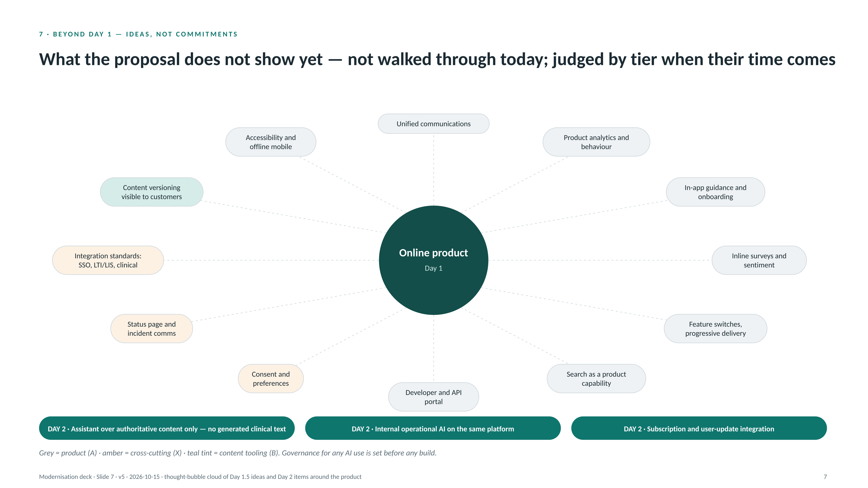
Notes:
HOW TO USE THIS SLIDE
- Do not walk the bubbles. Say: 'these are the things the proposal does not show yet; each is judged by its tier when its time comes; none is a commitment today.' Then take questions on any that interest the room.
DAY 1.5 — GAPS IN THE PROPOSED VIEW (each judged by its tier)
- Tier A: unified communications (email, SMS, in-app) — also the AI platform's channel later; product analytics and behavioural telemetry (what is used, where people struggle); in-app guidance and onboarding; inline surveys and sentiment; feature flags and progressive delivery (a Tier A prerequisite from slide 4, not a nice-to-have); search as a product capability; a developer and API portal for third parties and institutions; accessibility conformance and offline mode for mobile.
- Tier X: consent and preference management; a public status page and incident communications; integration standards — SSO/SAML (Shibboleth where universities require it), LTI/LIS for learning platforms, clinical standards where third-party systems expect them.
- Tier B: content versioning visible to customers — what changed, when, why.
- None of these is a major build on its own; the point is that the proposal captures systems, not the product experience or how the organisation will learn from use.
DAY 2
- Private AI platform, customer-facing: an assistant over authoritative content only, with citations and no generated clinical text. Governance (sources, scope, sign-off) is set before any build.
- Private AI platform, internal operations: the same platform woven into content, commerce and support processes — the operational AI described on slide 2.
- Subscription and user-update integration: as proposed; event-driven from the bus.
[PROMPT] Integration-standards example: an SSO, LTI or similar decision that opened a market segment (universities, institutions) — what it took and what it unlocked.

Slide 8
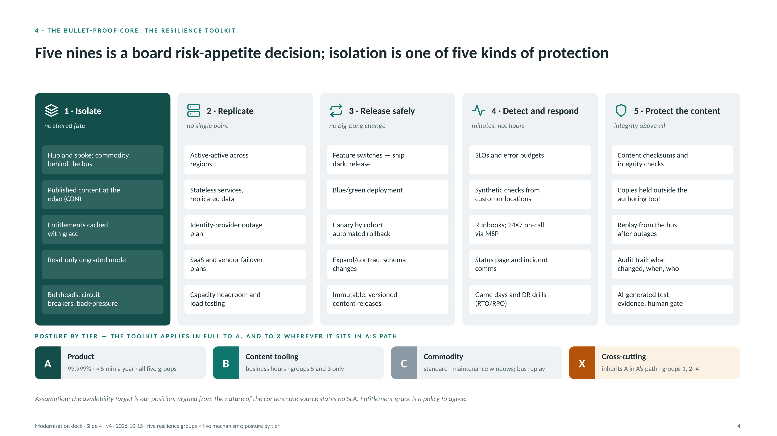
Notes:
BACKUP SLIDE — for 'how' questions on availability.
FRAMING
- Five nines (99.999%, roughly five minutes of unavailability a year) is our position, argued from the nature of the content: clinicians rely on it at the point of care. It is a risk-appetite decision for the board, and the slide presents it as one. The source states no SLA.
- Isolation (hub and spoke, slide 3) is one of five kinds of protection. A single mechanism never gets a product to five nines.
THE FIVE GROUPS
1 Isolate — no shared fate: hub and spoke with commodity behind the bus; published content at the edge; entitlements cached with grace; a read-only degraded mode; bulkheads, circuit breakers and back-pressure so one slow dependency cannot take the product down.
2 Replicate — no single point: active-active across regions; stateless services with replicated data; an identity-provider outage plan; SaaS and vendor failover plans; capacity headroom proven by load testing.
3 Release safely — no big-bang change: feature switches (ship dark, release deliberately); blue/green deployment; canary by cohort with automated rollback; expand/contract schema changes; immutable, versioned content releases.
4 Detect and respond — minutes, not hours: SLOs and error budgets; synthetic checks from customer locations; runbooks with 24×7 on-call via the MSP; a status page and incident communications; game days and DR drills with stated RTO/RPO.
5 Protect the content — integrity above all: checksums and integrity checks on published content; copies held outside the authoring tool; replay from the bus after outages; an audit trail of what changed, when and by whom; AI-generated test evidence behind a human gate.
POSTURE BY TIER
- A: all five groups. B: groups 5 and 3 — business hours, vendor SLA, published copy held outside the tool. C: standard — maintenance windows, events replayed from the bus. X: inherits A wherever it sits in A's path — groups 1, 2 and 4.
- Cost sits where the risk is: this is also the argument for not over-engineering Tier C.
CANDIDATES DELIBERATELY LEFT OFF THE SLIDE
- Chaos engineering as a standing practice (beyond game days); multi-CDN is covered on slide 4b.
[PROMPT] Life-critical availability example: a clinical or health-information system you ran where downtime had patient consequences — what the operating discipline looked like and what it cost.

Slide 9
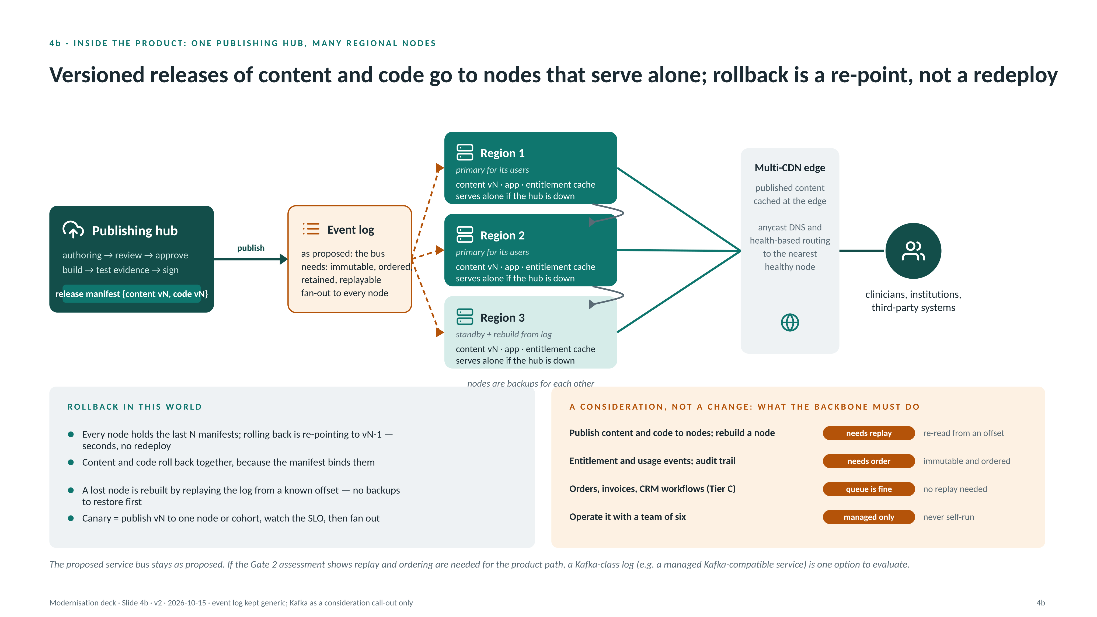
Notes:
BACKUP SLIDE — for questions on publishing, rollback, regions and the event backbone.
TWO HUB-AND-SPOKES, NOT ONE
- Slide 3 is the integration hub-and-spoke: the product versus everything else, across the whole architecture. This slide is the distribution hub-and-spoke inside the product: one publishing hub, many regional nodes.
THE FLOW
- Publishing hub: authoring → review → approve for content; build → test evidence → sign for code. The output is a release manifest that binds content vN and code vN together.
- Event log (as proposed, the bus): the manifest is published once and fanned out to every node. The product path needs the log to be immutable, ordered, retained and replayable — those are requirements, not a product choice.
- Regional nodes: each holds the content version, the app and an entitlement cache, and serves alone if the hub is down. Nodes are backups for each other. Region 3 is drawn as a standby that is rebuilt from the log rather than restored from backup.
- Multi-CDN edge: published content cached at the edge; anycast DNS with health-based routing sends users and third-party systems to the nearest healthy node.
ROLLBACK IN THIS WORLD
- Every node holds the last N manifests; rolling back is re-pointing to vN-1 — seconds, no redeploy. Content and code roll back together because the manifest binds them. A lost node is rebuilt by replaying the log from a known offset. Canary means publishing vN to one node or cohort, watching the SLO, then fanning out.
A CONSIDERATION, NOT A CHANGE
- The proposed service bus stays as proposed. The panel lists what each path needs: publish/rebuild needs replay; entitlement, usage and audit need ordering; Tier C workflows only need a queue; and whatever is chosen must be a managed service for a team of six.
- If the Gate 2 assessment shows the product path needs replay and ordering, a Kafka-class log (for example a managed Kafka-compatible service) is one option to evaluate. Do not present this as a decision.
ASSUMPTIONS
- The proposal's "API gateway / enterprise service bus" is undefined in the source; number and location of regions are illustrative.

